Slide 1
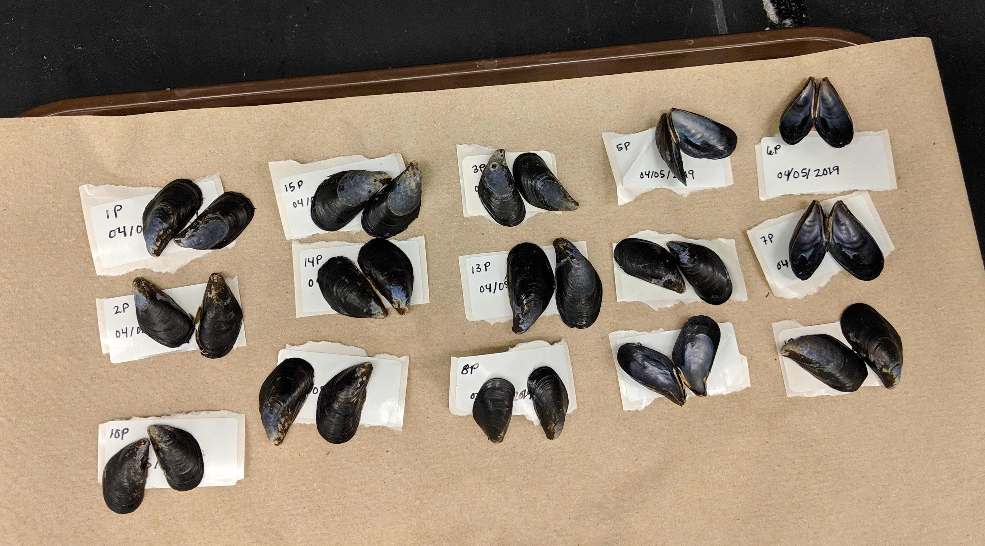
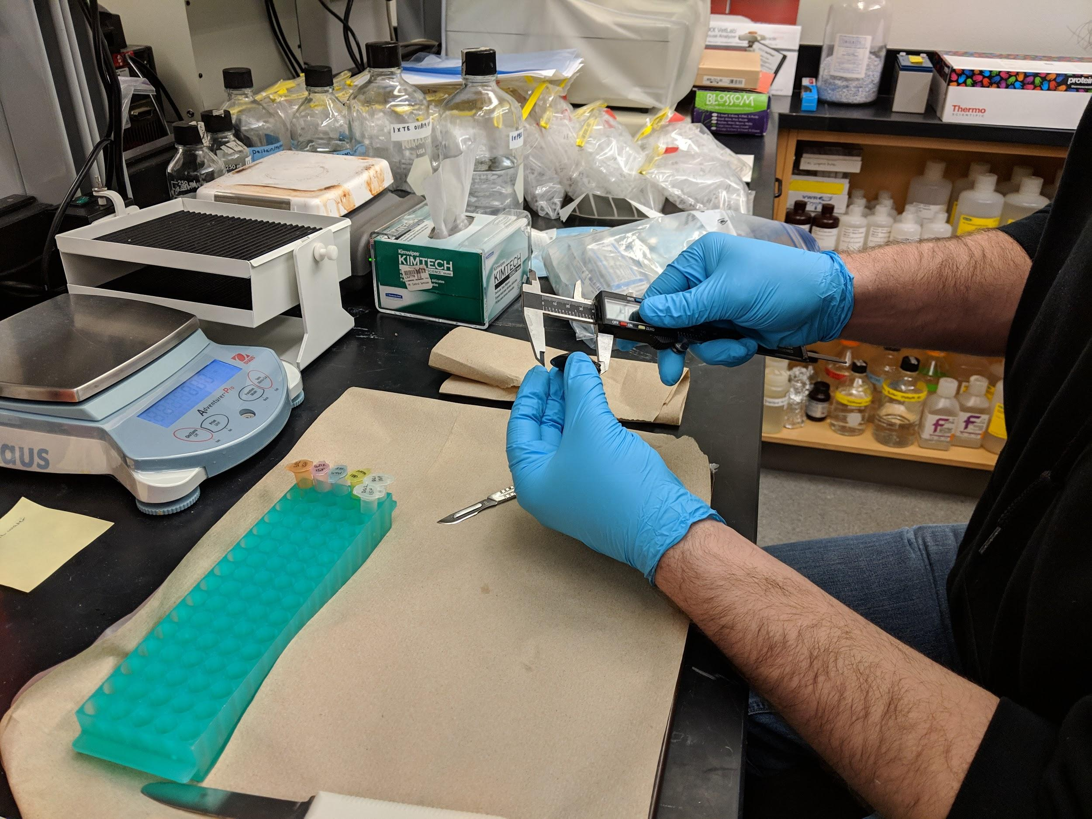

ADAC Year 6 Annual Meeting
ADAC Project Briefing
“Photo-enhanced toxicity of dispersed and burned crude oil to Arctic mussels.”
Patrick Tomco, Ph.D
Department of Chemistry
University of Alaska Anchorage

Slide 2
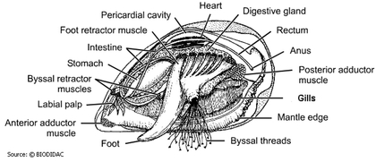
Photo-enhanced toxicity of dispersed and burned crude oil to Arctic mussels
ADAC Program Year 6 Annual Meeting 14 May 2020
Project Principal Investigator:
Patrick Tomco, Ph.D
University of Alaska Anchorage
Supporting Team:
Colin McGill, Ph.D, UAA
Katrina Counihan, Ph.D, Alaska Sealife Center
Phoebe Zito, Ph.D, University of New Orleans
Student Participation:
Anastasia Hanson, Kevin Fitzpatrick, and Cameron Carlson
Project Champion:
LTCR John LaMorte

Slide 3
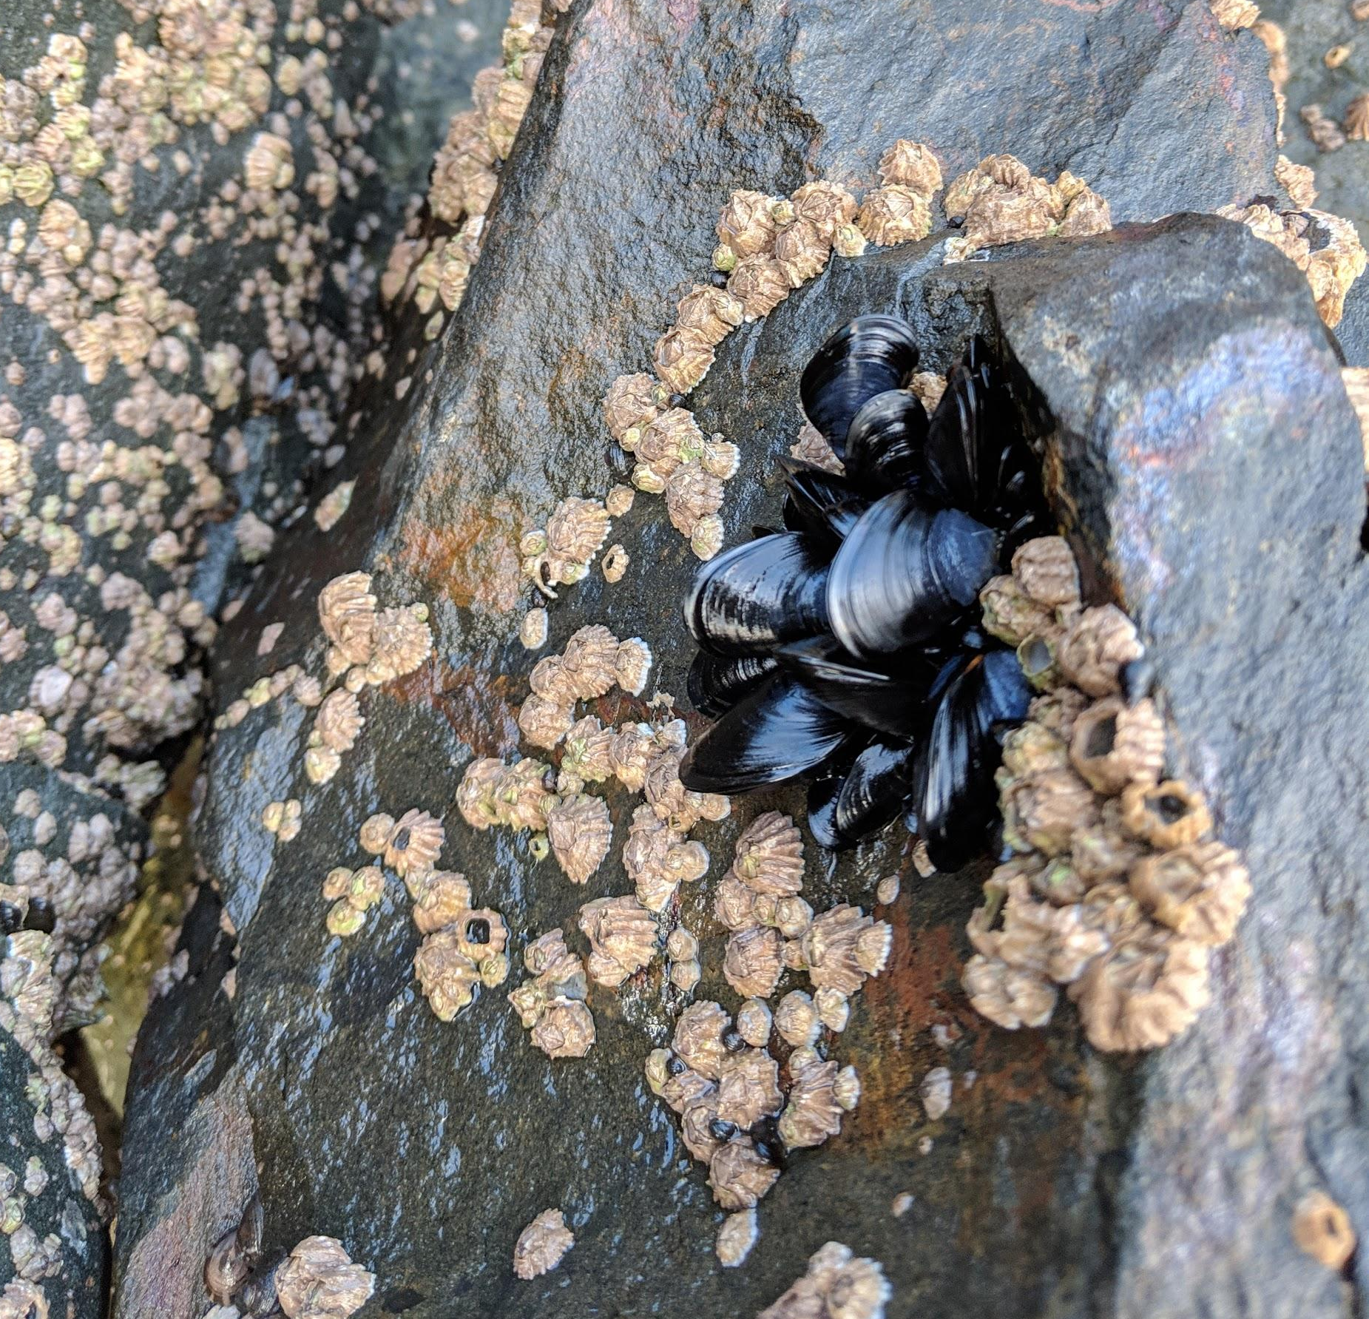
Photo-enhanced toxicity of dispersed and burned crude oil to arctic mussels: Description and Baseline
ADAC Program Year 6 Annual Meeting 14 May 2020
Project assesses the impact burned vs dispersed crude oil has on marine life and if seasonal sunlight differences change the efficacy of either recovery method.
The toxicity of dispersed or burned oil to marine organisms can differ from untreated oil
Photo-enhanced toxicity (i.e. the increase in toxicity associated with the presence of sunlight) of crude oil is documented
The toxicological impacts of dispersed vs. burned crude oil exposure in the presence/absence of sunlight toward Arctic mussels have never been assessed in the extreme environmental conditions of the Arctic.

Slide 4
Photo-enhanced toxicity of dispersed and burned crude oil to arctic mussels: Relevance
ADAC Program Year 6 Annual Meeting 14 May 2020
Relevance to DHS and USCG
  Results can be applied to management decisions on the use of recovery methods
  A set of knowledge products useful for USCG to apply to a spill response scenario

Slide 5
ADAC Program Year 6 Annual Meeting 14 May 2020
Photo-enhanced toxicity of dispersed and
burned crude oil to arctic mussels: Research Objectives
Objective 1: Exposure Experiments
    Conduct static exposure tests with bay mussels in seawater with oil, Corexit 9500, oil dispersed with Corexit 9500, and oil subjected to in-situ burn with three different photoperiods.
Objective 2: Physiological/Biochemical Assays
    Assess physiological and biochemical responses of bay mussels to the oil, dispersant, and in-situ burned oil in the exposure tests at different time points.
Objective 3: Metabolomics
    Evaluate metabolic health of mussels in the exposure tests using metabolomics.
Objective 4: Chemical Analysis
    Profile the chemical constituencies of oil, dispersed oil, and burned oil treatments used in the mussel exposures and how each treatment chemically weathers throughout the experiment.
Objectives incorporated as Phases into timeline

Slide 6
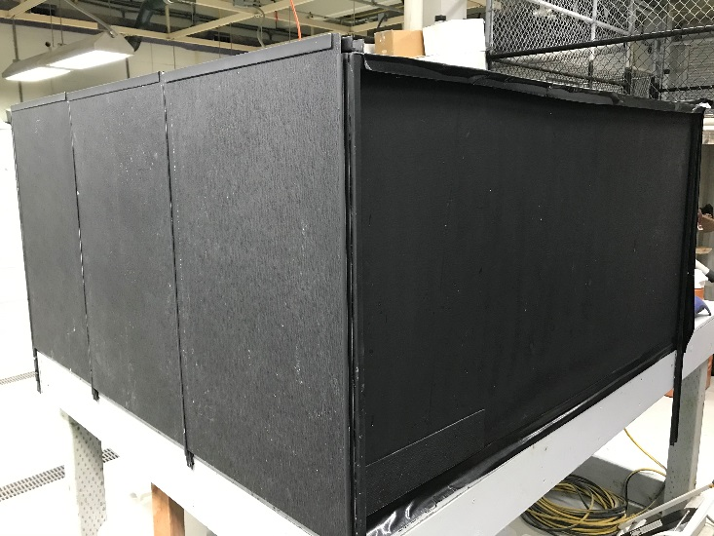
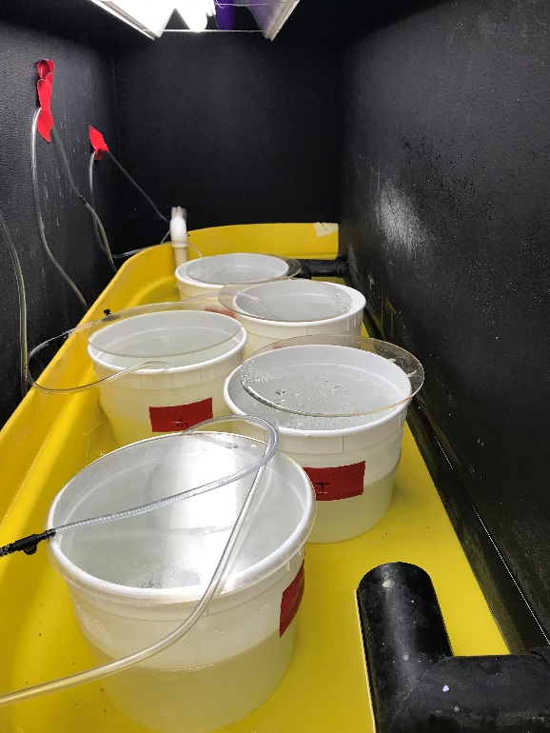
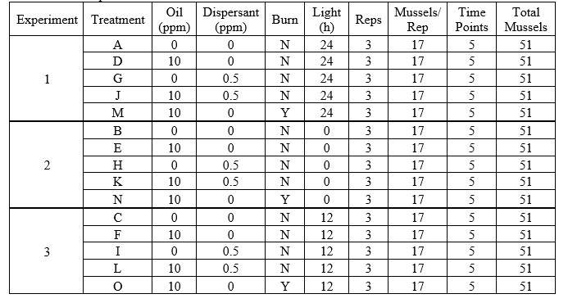
ADAC Program Year 6 Annual Meeting 14 May 2020
Progress in meeting research methods:
(Completed Phase 1)
Phase 1 steps:
1. Construct Exposure apparatus
2. Collect Mytilus trossulus from Resurrection Bay
3. Conduct laboratory-based exposure.
  Three exposures completed in September, October, and November

Slide 7
ADAC Program Year 6 Annual Meeting 14 May 2020
Milestones from Phase 1 (all complete):
  Team members participated in kick-off meeting with Project Champion
  Team member Counihan (ASLC) constructed exposure chambers in Seward, AK
  Mussels were harvested from Resurrection Bay, AK
  Mussels were acclimated in exposure chambers for 1-2 weeks
  Mussels were dosed with oil, dispersed oil, and burned oil under light and dark conditions.
  Mussels were harvested at 0, 1, 4, and 7 days post-treatment
  Mussels were dissected and tissues archived for Phase 2 and 3
  Water samples were collected and mailed to Team member Zito (UNO).

Slide 8
ADAC Program Year 6 Annual Meeting 14 May 2020
Metrics for Phase 1 (all complete)
Metrics for Phase 1:
Task A: Obtain approved State of Alaska Department of Fish and Game aquatic resource permit for hand collection of Mytillus trossulus in Resurrection Bay
Task B: Obtain approved hazardous waste disposal and chemical safety approval.
Task C: Construct 15 exposure chambers. Each capable is suitable for safely containing 50 mussels in 5L seawater and containing oil in the event of a spill.
Task D: Collect >750 mussels from Resurrection Bay suitable for exposure assessment. Transport to exposure chambers.
Task E: Successfully acclimate test organisms to exposure chambers. Record data on mortality. Ensure 50 mussels per exposure chamber are acclimated.
Task F: Successfully collect burn residue from 3 small-scale controlled in-situ burns.
Task G: Expose collected mussels to 5 conditions: seawater, dispersant, oil, dispersed oil, and burned oil) under 3 light regiments. Organisms are harvested on the defined time intervals and dissected with the tissues archived, masses recorded, and recordings of mortality rates.
Completed
Completed
Completed
Completed
Completed
Completed
Completed

Slide 9
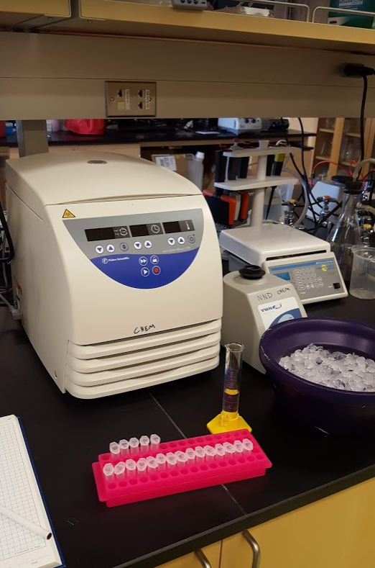
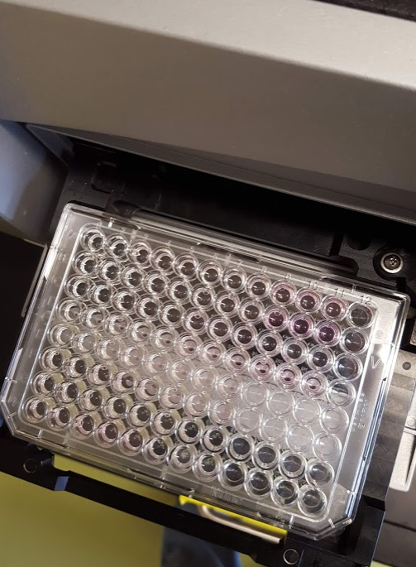

ADAC Program Year 6 Annual Meeting 14 May 2020
Progress in meeting research methods, Phase 2
Phase 2 (in progress): physiological and biochemical assays
  Hydrogen peroxide formation in hemolymph
  RNA:DNA ratio in mantle
  Cytochrome P450 in digestive gland
  Heat Shock Protein in gill
  Superoxide dismutase in digestive gland
  Micronuclei in gill
  TBARS assay from gills
  ATP/ADP ratio from mantle
  Caspase 3/7 from gills
  Perform Statistical Analysis

Slide 10
ADAC Program Year 6 Annual Meeting 14 May 2020
Progress on Milestones – Phase 2
Upon completion of Phase 1, team member Counihan (ASLC) will complete the following analyses (anticipating 1-2 will be complete in ADAC Program Year 5 and 3-6 will complete in ADAC Program Year 6):
  Hydrogen peroxide formation in hemolymph
  RNA:DNA ratio in mantle
  Cytochrome P450 in digestive gland
  Heat Shock Protein in gill
  Superoxide dismutase in digestive gland
  Micronuclei in gill
Upon completion of Phase 1, team member McGill (UAA) will
complete the following analyses (anticipating will be complete in
ADAC Program Year 6):
  TBARS assay
  ATP/ADP ratio
  Caspase 3/7
Completed
Completed
(in progress)
Completed
(in progress)
(in progress)
Completed
(in progress)
(in progress)

Slide 11
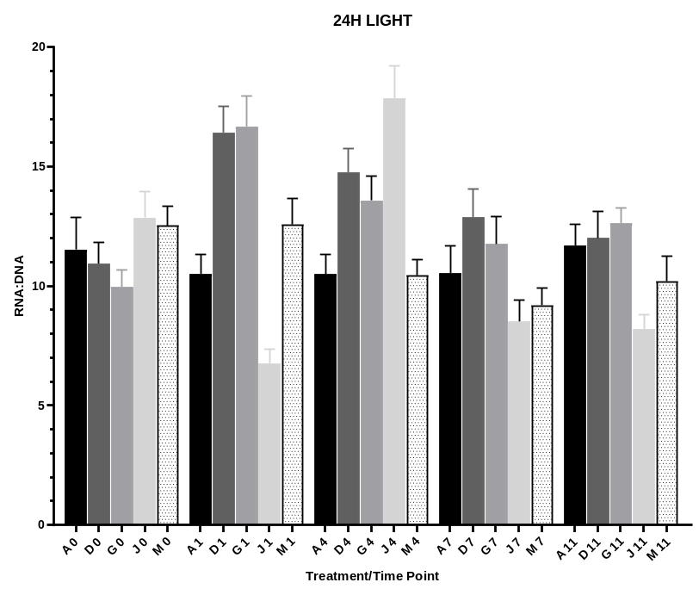
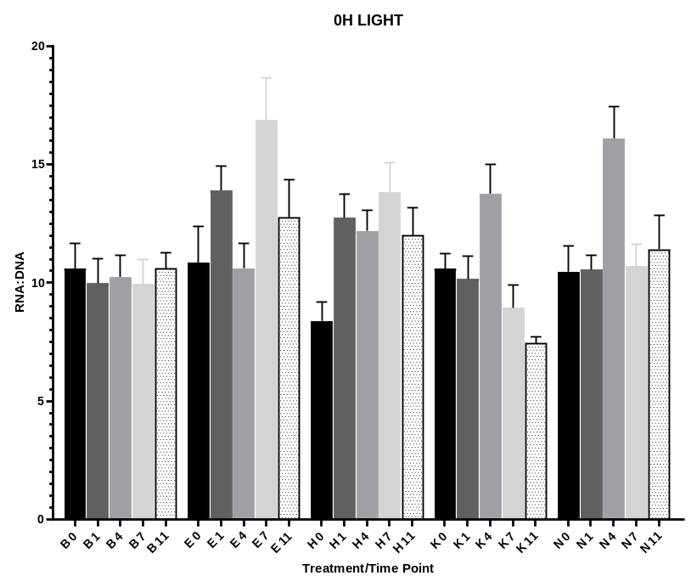
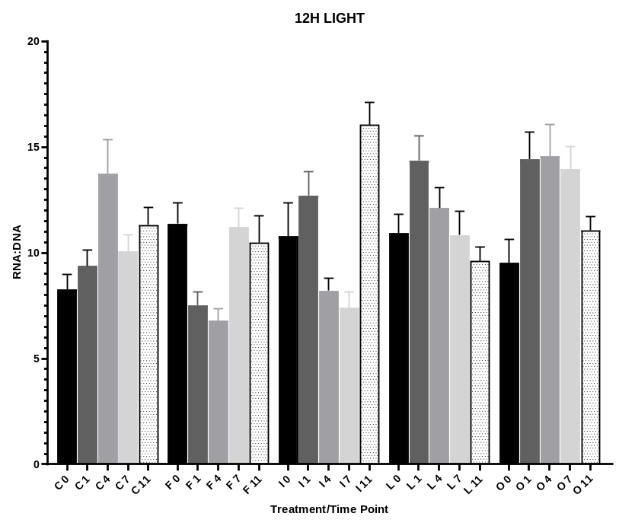
ADAC Program Year 6 Annual Meeting 14 May 2020
Arctic Mussels Project: Phase 2 Metrics (RNA:DNA)
A,B,C = seawater control; D,E,F = 10ppm oil; G,H,I = 0.5ppm Corexit;
J,K,L = 10ppm oil + 0.5ppm Corexit; M,N,O = 10ppm oil burned
0,1,4,7,11 = time in days

Slide 12
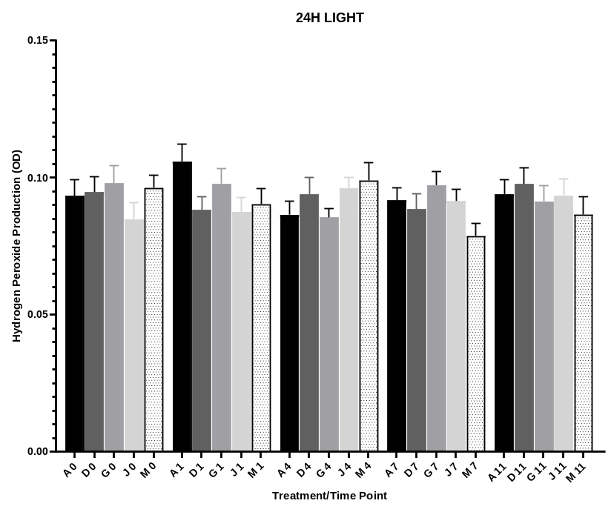
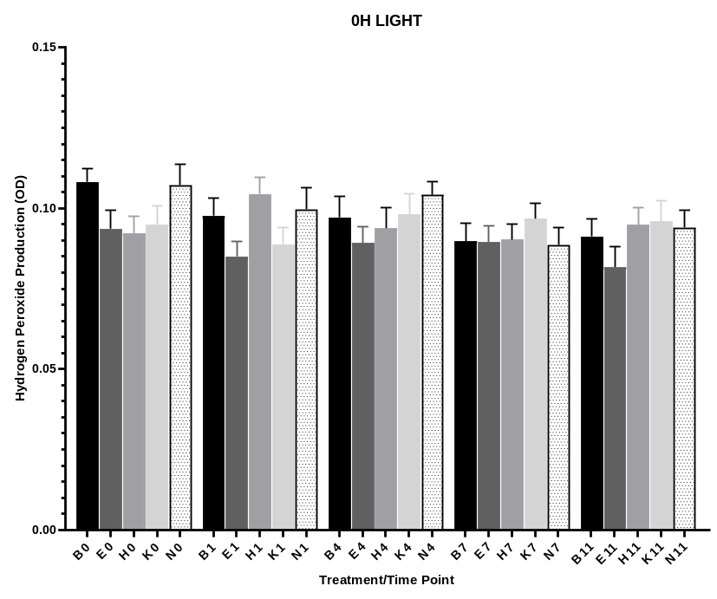
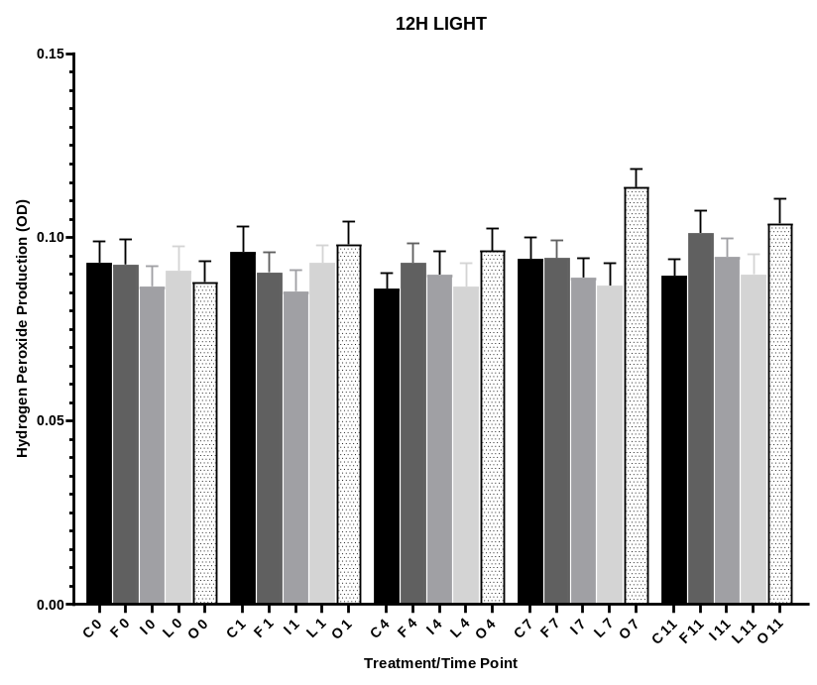
ADAC Program Year 6 Annual Meeting 14 May 2020
Arctic Mussels Project: Phase 2 Metrics (Hydrogen Peroxide)
A,B,C = seawater control; D,E,F = 10ppm oil; G,H,I = 0.5ppm Corexit;
J,K,L = 10ppm oil + 0.5ppm Corexit; M,N,O = 10ppm oil burned
0,1,4,7,11 = time in days

Slide 13
Arctic Mussels Project: Phase 2 Metrics
ADAC Program Year 6 Annual Meeting 14 May 2020
Preliminary Data: TBARS
TBARS is probably the oldest and one of the most widely used assays for measuring the lipid peroxidation end product malondialdehyde, a reactive aldehyde produced by lipid peroxidation of polyunsaturated fatty acids.
This allows for an indirect measure of reactive oxygen species (ROS) and provides insight into an organism's level of redox stress.
All y-axis data is has the units of (uM of MDA) / (mg/mL of protein extracted)
Error bars are one standard error of mean
Time points are from treatment, final time point (rec) if taken after 4 days of clean seawater post exposure to assess recovery

Slide 14
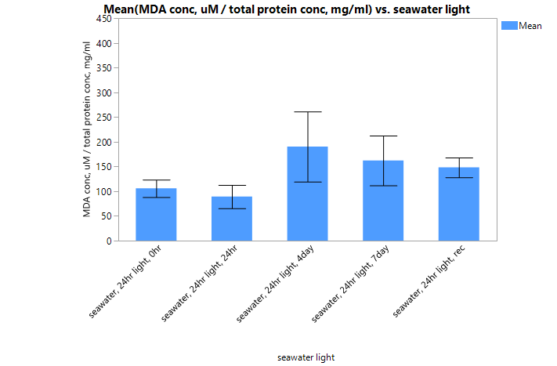
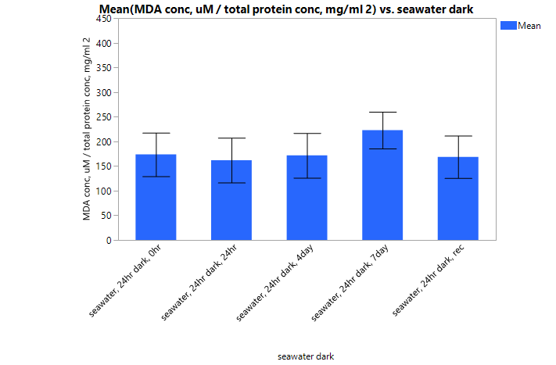
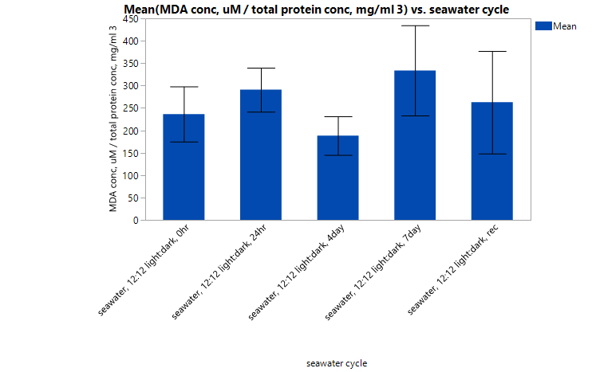
ADAC Program Year 6 Annual Meeting 14 May 2020
24 hr Light
0 hr Light
12 hr Light
Mussels with Seawater
(Baseline variation)

Slide 15
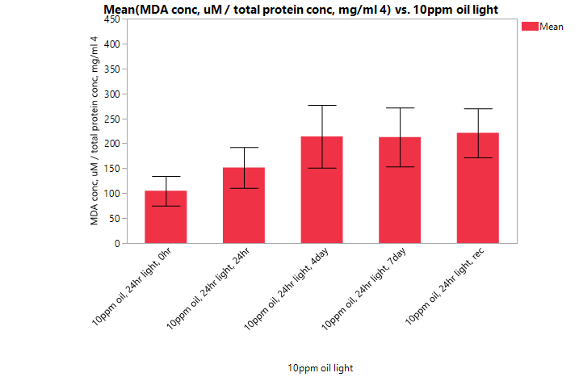
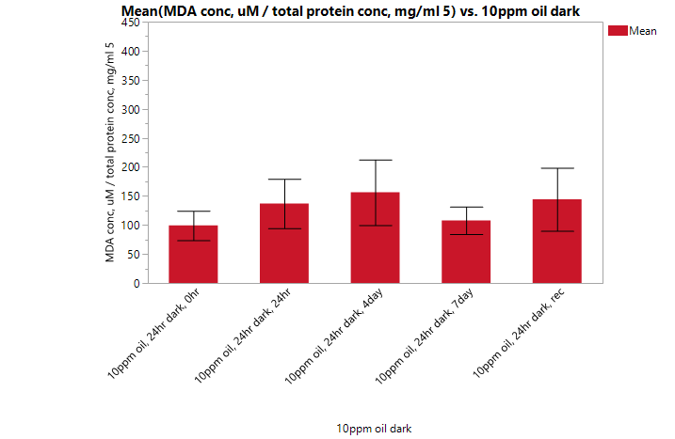
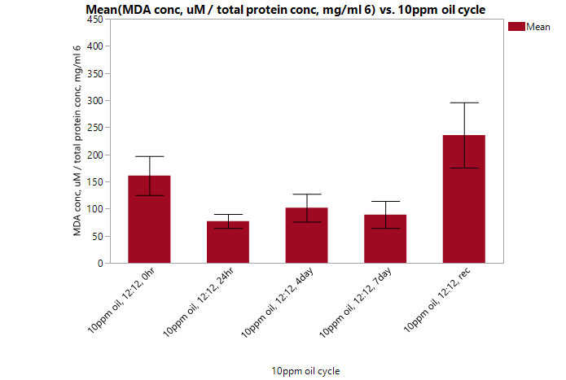
ADAC Program Year 6 Annual Meeting 14 May 2020
24 hr Light
0 hr Light
12 hr Light
Mussels with Seawater + Oil

Slide 16
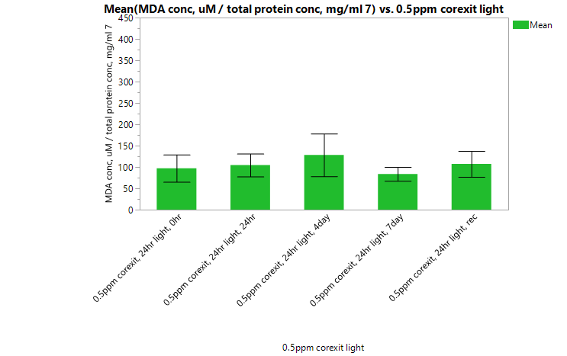
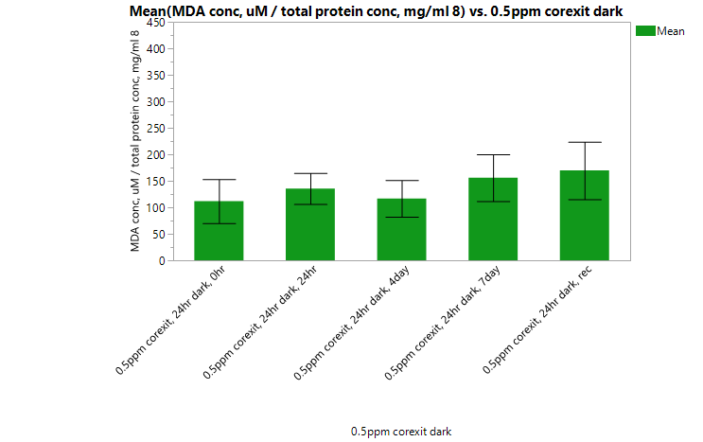
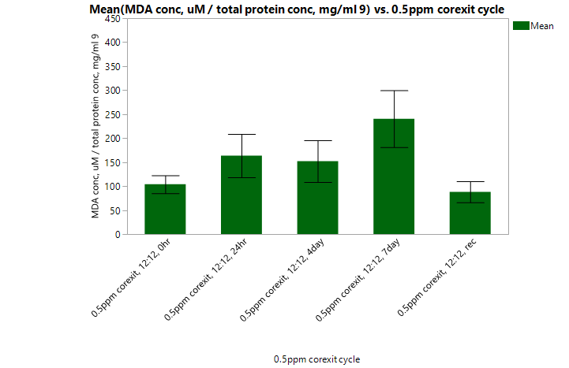
ADAC Program Year 6 Annual Meeting 14 May 2020
24 hr Light
0 hr Light
12 hr Light
Mussels with Seawater + Dispersant

Slide 17
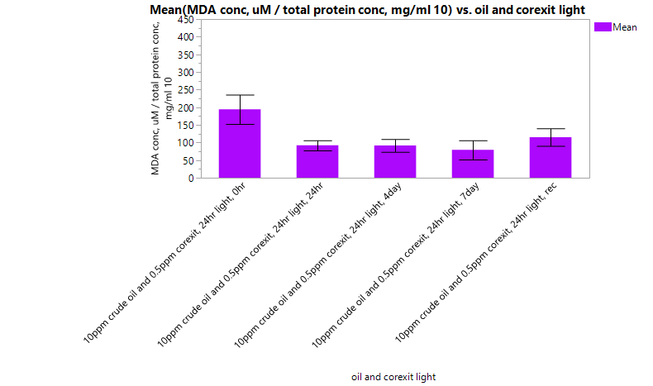
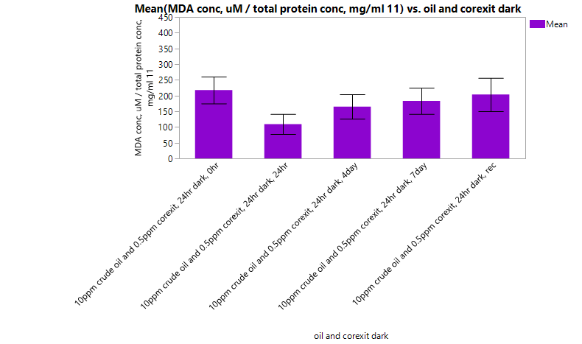
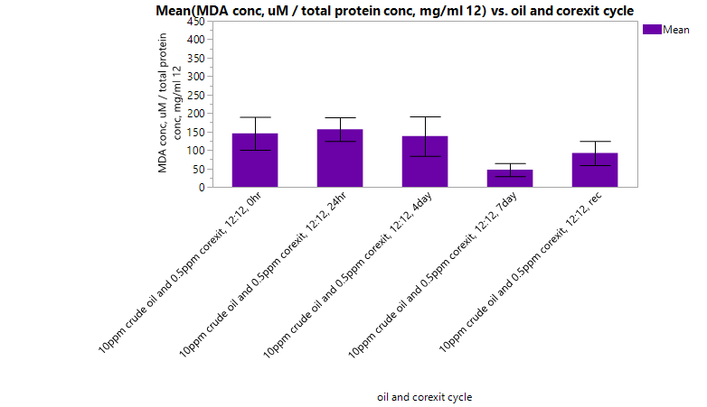
ADAC Program Year 6 Annual Meeting 14 May 2020
24 hr Light
0 hr Light
12 hr Light
Mussels with
Seawater + Oil + Dispersant

Slide 18
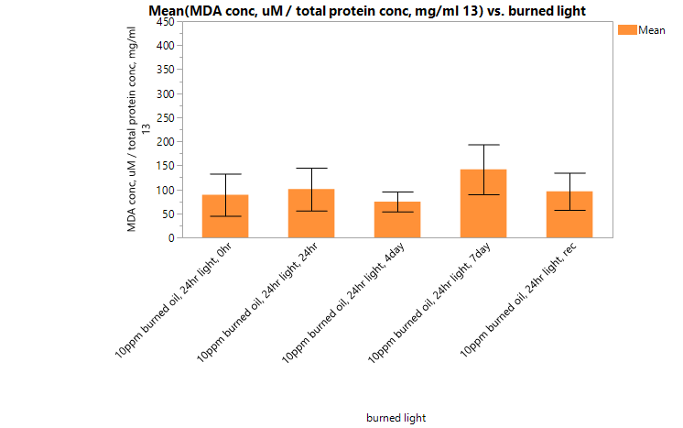
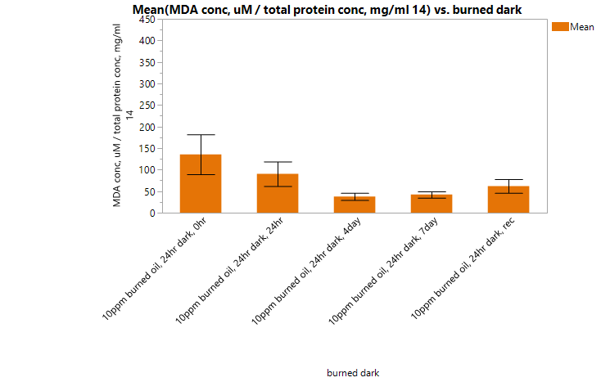
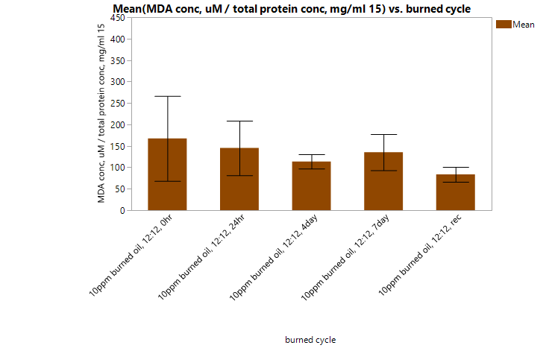
ADAC Program Year 6 Annual Meeting 14 May 2020
24 hr Light
0 hr Light
12 hr Light
Mussels with
Seawater + Burned Oil

Slide 19
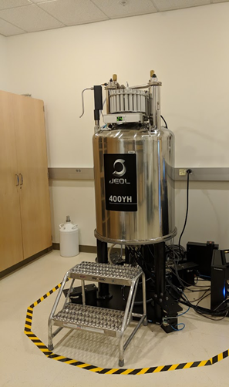
ADAC Program Year 6 Annual Meeting 14 May 2020
Arctic Mussels Phase 3: progress in meeting research methods
Metabolomics analysis
  extract metabolites
  obtain spectra using 1H NMR 400MHz
  identify peaks using Chenomx software
  statistical anaylsis using PLS toolbox and R

Slide 20
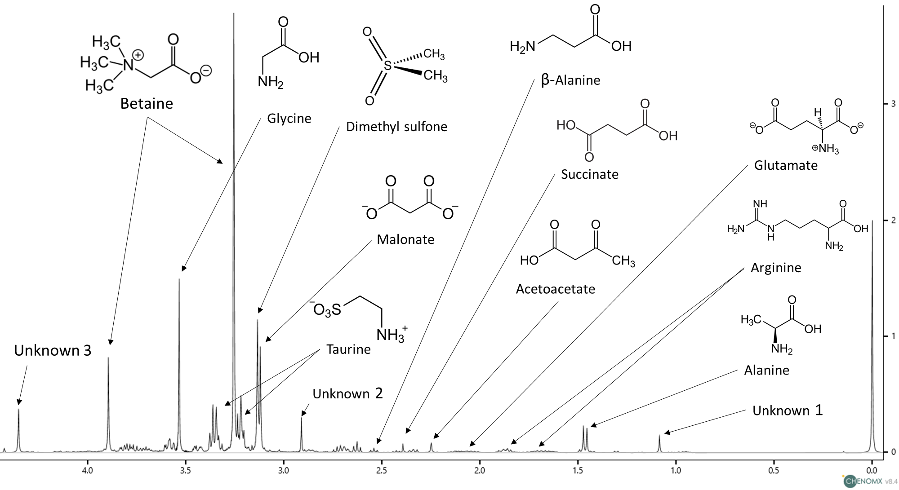
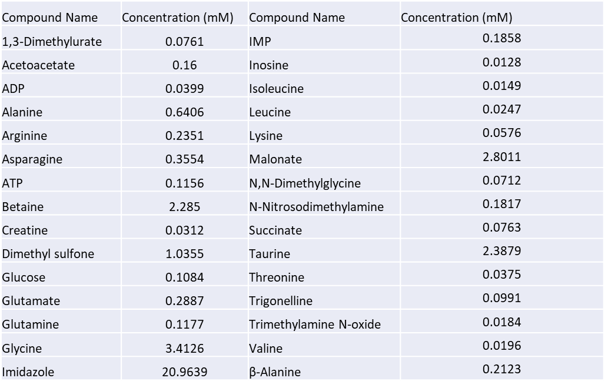
Arctic Mussels Phase 3: Metabolomics
ADAC Program Year 6 Annual Meeting 14 May 2020
Metrics for Phase 3:
Task A: Documentation of NMR spectra from tissue extracts.
Task B: Using NMR spectra, identify small molecule metabolites present in tissues based on database matches.
Task C: Statistically compare differences in metabolite profiles between treatments, across time, and between individuals.
  Tomco to evaluate and quality control the data.
Complete
Complete
(in progress)

Slide 21
Arctic Mussels Phase 3: Metabolomics
ADAC Program Year 6 Annual Meeting 14 May 2020
Milestones for Phase 3:
Metabolites will be extracted from tissues and archived
NMR spectral data will be acquired at the University of Alaska Anchorage NMR facility
Chemical constituencies that correspond to primary metabolites (polar and nonpolar) found in the Human Metabolome Database will be identified
Concentrations of the identified metabolites will be determined
Multivariate statistical analysis (PCA) will be performed on binned NMR spectra (i.e. unsupervised metabolomics)
(in progress)
(in progress)
(in progress)
(in progress)
(in progress)

Slide 22
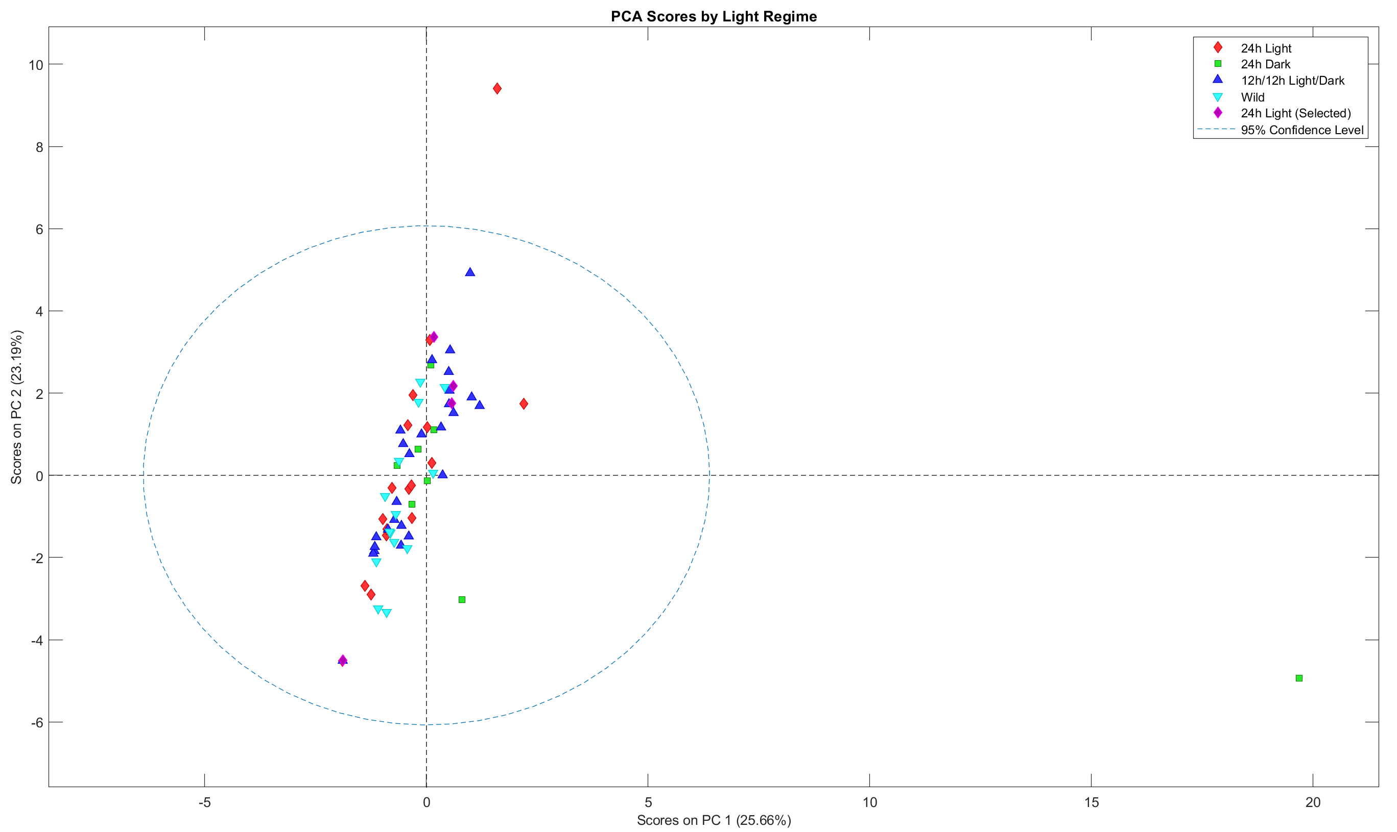
Arctic Mussels Phase 3: Metabolomics
ADAC Program Year 6 Annual Meeting 14 May 2020
PCA Scores Plot:
Sunlight effects
0 vs 12 vs 24 hr

Slide 23
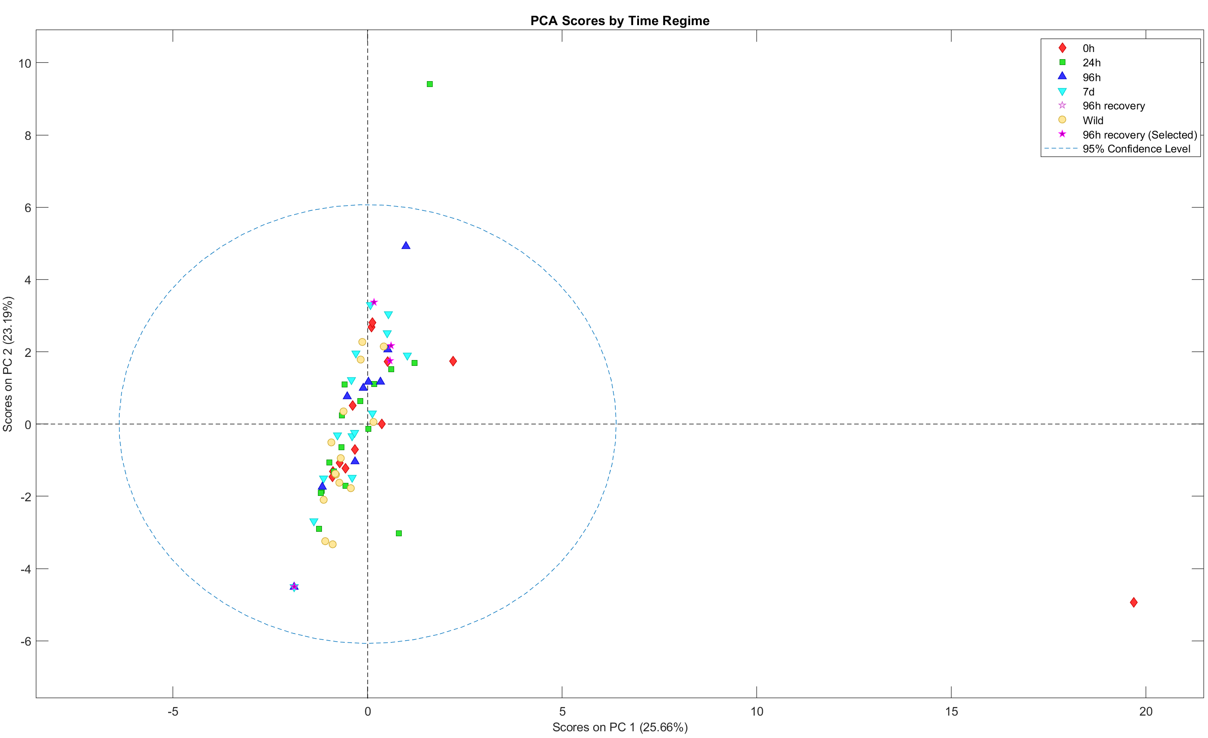
Arctic Mussels Phase 3: Metabolomics
ADAC Program Year 6 Annual Meeting 14 May 2020
PCA Scores Plot:
Time effects
0, 1, 4, 7, and 11 days

Slide 24
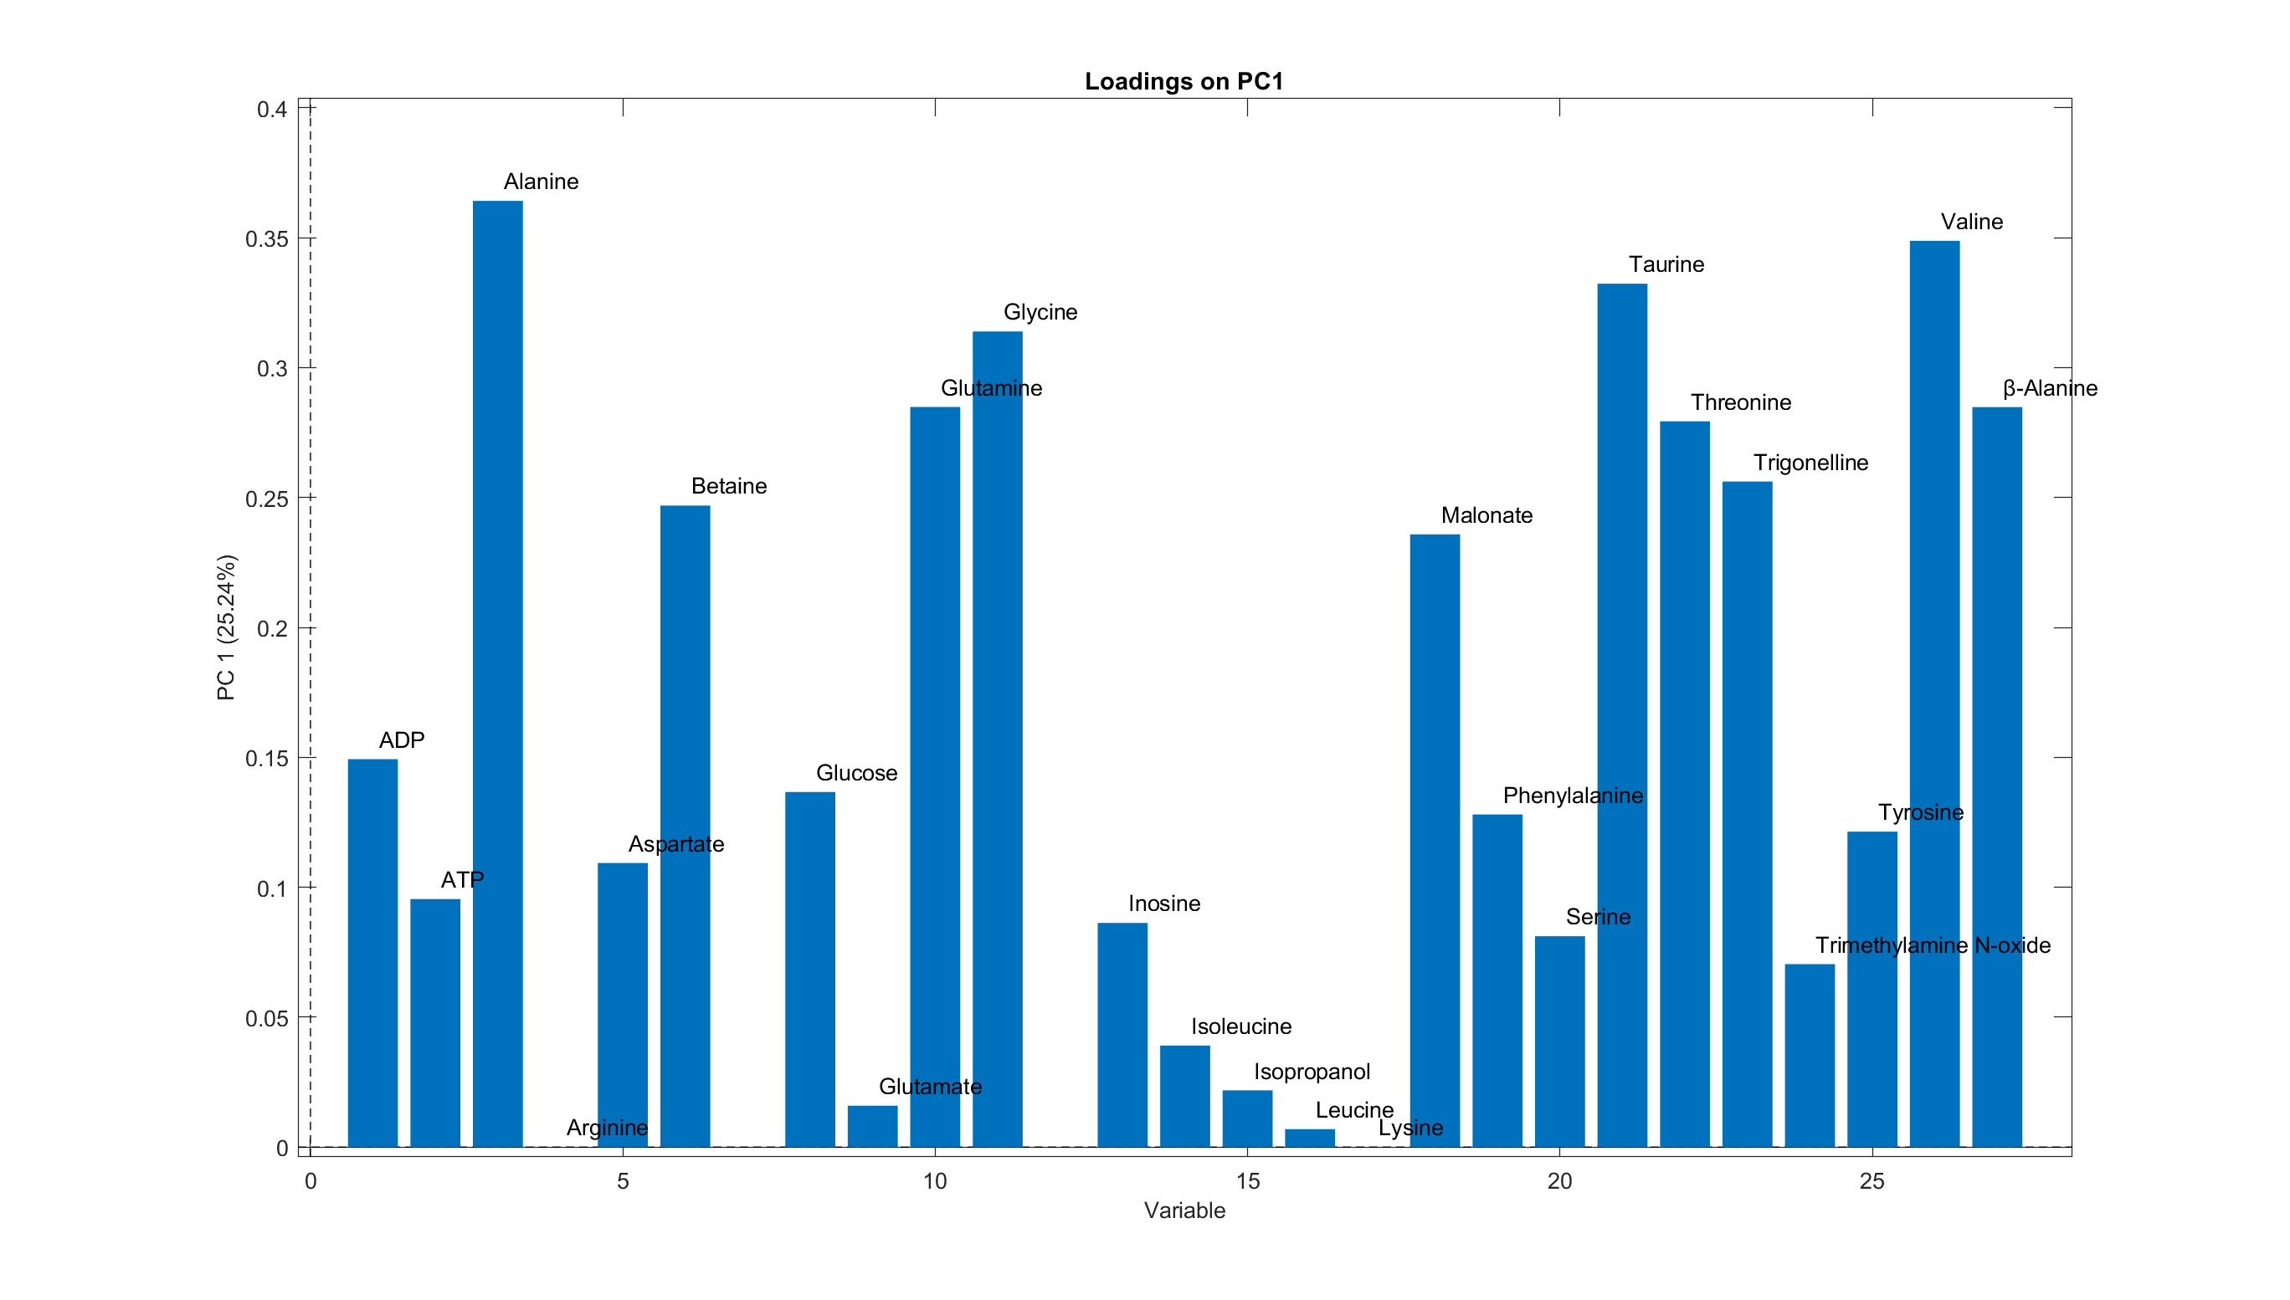
Arctic Mussels Phase 3: Metabolomics
ADAC Program Year 6 Annual Meeting 14 May 2020
PCA Loadings Plot:
Which metabolites explain
variance?

Slide 25
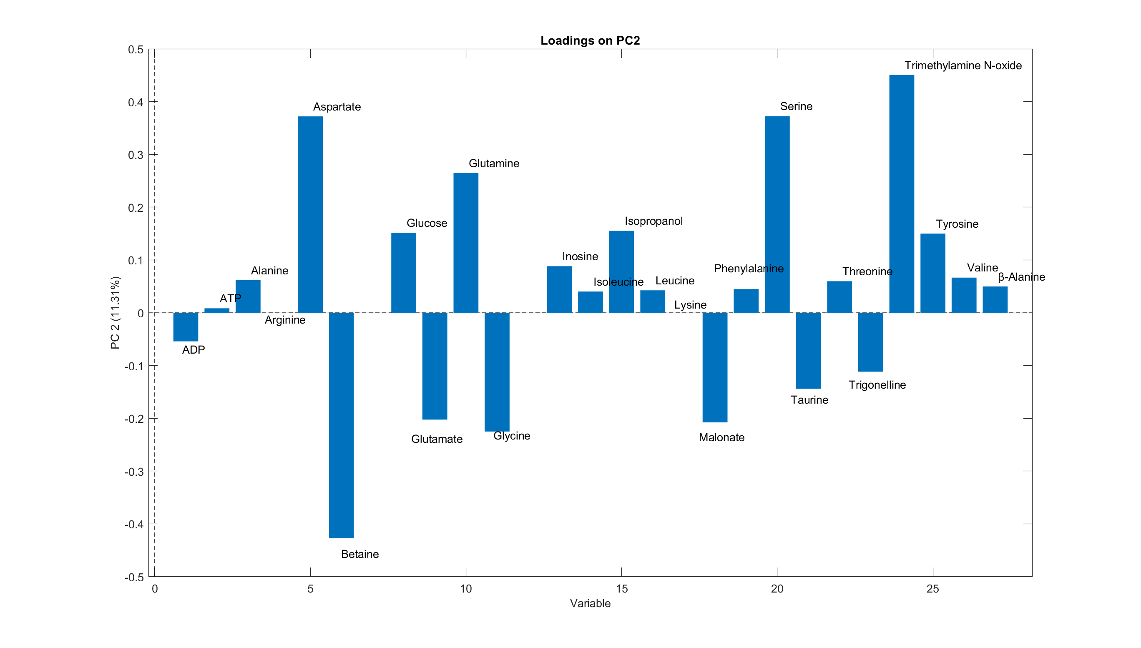
Arctic Mussels Phase 3: Metabolomics
ADAC Program Year 6 Annual Meeting 14 May 2020
PCA Loadings Plot:
Which metabolites explain
variance?

Slide 26
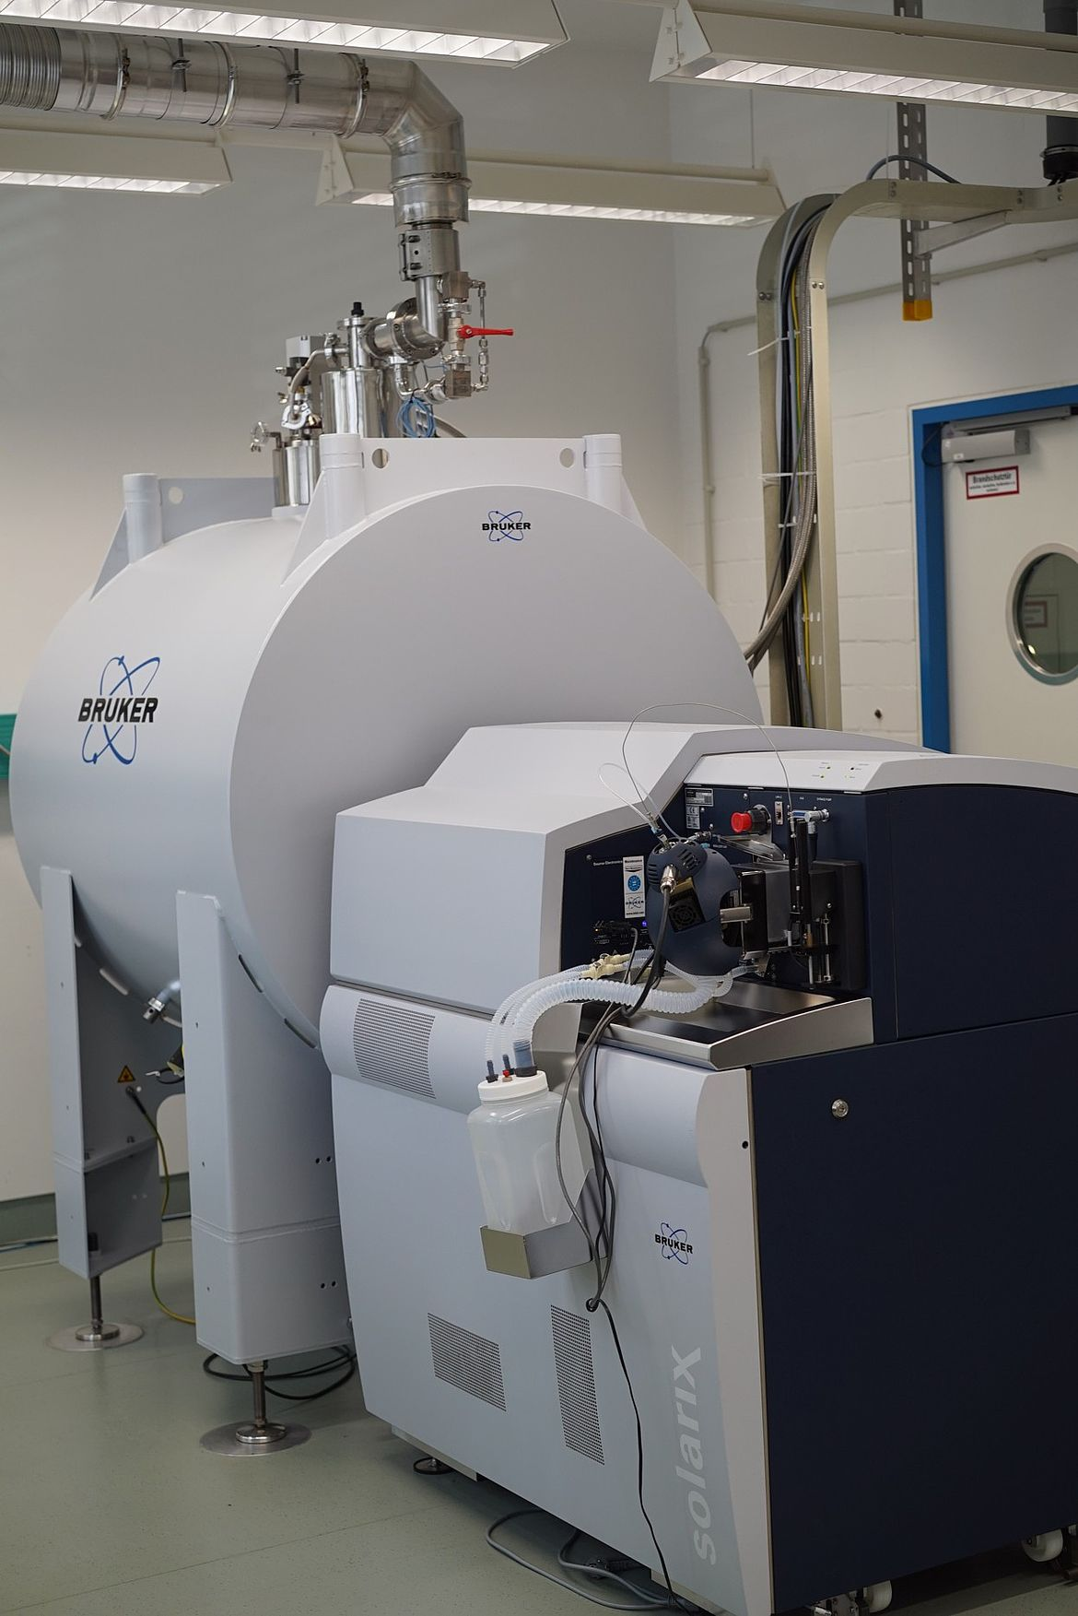
ADAC Program Year 6 Annual Meeting 14 May 2020
Arctic Mussels Phase 4: Progress in meeting research methods
Phase 4: Profiling chemical constituencies of water-accommodated petroleum and photo-degraded petroleum
  Dissolved Organic Carbon (DOC) Analyses
  Optical Analyses
  Fourier Transform Ion Cyclotron Mass Spectrometry (FT-ICR MS)

Slide 27
ADAC Program Year 6 Annual Meeting 14 May 2020
Arctic Mussels Phase 4: Metrics
Completed*
Task A: Obtain necessary instrument time permissions for 180 FT-ICR MS samples at the National High Magnetic Field Laboratory.
Task B: Document dissolved organic carbon concentrations in water samples
Task C: Document spectrofluorescence and FT-ICR MS data from water samples.
Task D: Statistically compare differences in DOC, spectrofluorescence and FT-ICR MS data between treatments, across time, and between replicates. Zito to evaluate and quality control the data.
Completed*
(in progress)
(in progress)

Slide 28
ADAC Program Year 6 Annual Meeting 14 May 2020
Arctic Mussels Phase 4: Milestones
Phase 4: Chemical Analyses. Upon completion of Phase 1 and once water samples have been received, Team member Zito will analyze the chemical composition of aqueous-phase hydrocarbons at the University of New Orleans.
Milestones anticipated:
The dissolved organic carbon (DOC) content of each water sample will be calculated
The three-dimensional fluorescence character of each water sample will be determined
Water samples will be pre-concentrated for FT-ICR Mass Spectra collection
FT-ICR MS data will be collected at the National High Field Magnetic Laboratory in Tallahassee FL

Slide 29
ADAC Program Year 6 Annual Meeting 14 May 2020
Dissolved Organic Carbon

Slide 30
ADAC Program Year 6 Annual Meeting 22-23 April 2019
Absorbance @ 254 nm

Slide 31
Seawater Control (Baseline) @ 1-day incubation
24 hr Light
0 hr Light
12 hr Light

Slide 32
Seawater + Oil @ @ 1 day incubation
24 hr Light
0 hr Light
12 hr Light

Slide 33
Seawater + Dispersant @ 1 day incubation
24 hr Light
0 hr Light
12 hr Light

Slide 34
Seawater + Dispersant + Oil @ 1 day incubation
24 hr Light
0 hr Light
12 hr Light

Slide 35
Seawater + Burned Oil @ 1 day incubation
24 hr Light
0 hr Light
12 hr Light

Slide 36
Arctic Mussels Phase 5: Progress in meeting research methods
Synthesize data and prepare knowledge products
Project personnel will meet to summarize the findings and identify appropriate peer-review journals for submission.
Team members Counihan and Zito will lead the manuscript preparation and submission aspects to peer-reviewed scientific journals (i.e. Aquatic Toxicology, Environmental Science and Technology).
PI Tomco will work with ADAC and USCG Project Champion in synthesizing data to meet USCG needs and satisfying reporting outcomes as required by the program.
Team member McGill and graduate students will assist in all aspects of reporting and manuscript preparation.

Slide 37
Arctic Mussels: Schedule and Metrics
ADAC Program Year 6 Annual Meeting 14 May 2020
Current year research schedule and milestones:
  Phase 1 – Complete
  Phase 2 – In Progress
  Phase 3 – In Progress
  Phase 4 – In Progress
  Phase 5 – Upon completion of Phases 1-4 in Yr 7
Current year metrics:
  Progress on Phases 2-4
  (Dependent on lab accessibility in Yr 6)

Slide 38
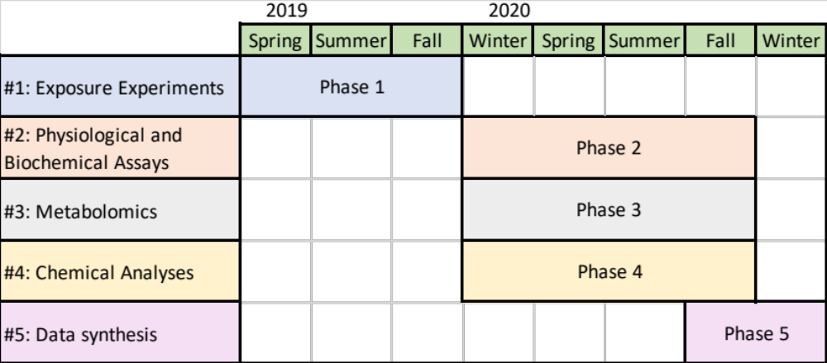
Arctic Mussels: Planned Research Outcomes
ADAC Program Year 6 Annual Meeting 14 May 2020
Phase 2 – In Progress, planned Yr 7 completion
Phase 3 – In Progress, planned Yr 7 completion
Phase 4 – In Progress, planned Yr 7 completion
The Outcome/output of this research project is to provide a knowledge product publishing the research conducted, analysis, conclusions and recommendations. The published works will include peer-reviewed scientific article(s).
Updated workplan
(before COVID-19)

Slide 39
Arctic Mussels: Key Accomplishments
ADAC Program Year 6 Annual Meeting 14 May 2020
Key accomplishments of the project:
  Permits obtained
  Engagement with Project Champion
  Exposure chamber build-out
  Mussel harvest
  Exposures conducted
  Tissues dissected
  Samples distributed
  Approximately half of toxicity data collected
  Approximately half of water samples processed
  Three (or four) students trained

Slide 40
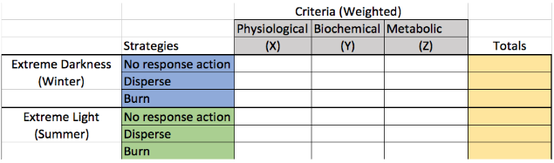
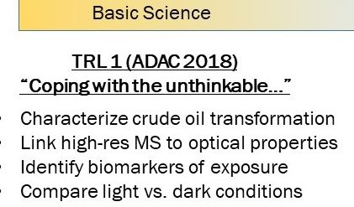
Arctic Mussels: Transition Plans
ADAC Program Year 6 Annual Meeting 14 May 2020
Translating toxicity data generated into policy decisions and criteria for recovering spilled oil requires not only controlled experiments conducted under simulated realistic scenarios and complex data analysis; it also requires a “global perspective” cost/benefit weighing.

Slide 41
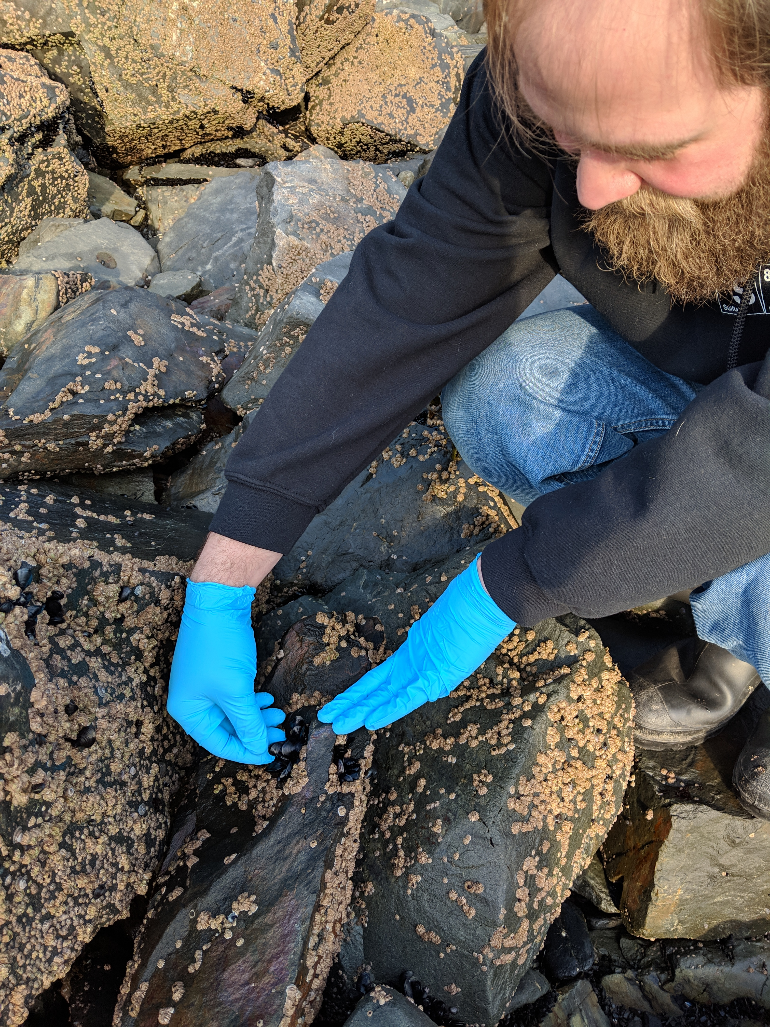
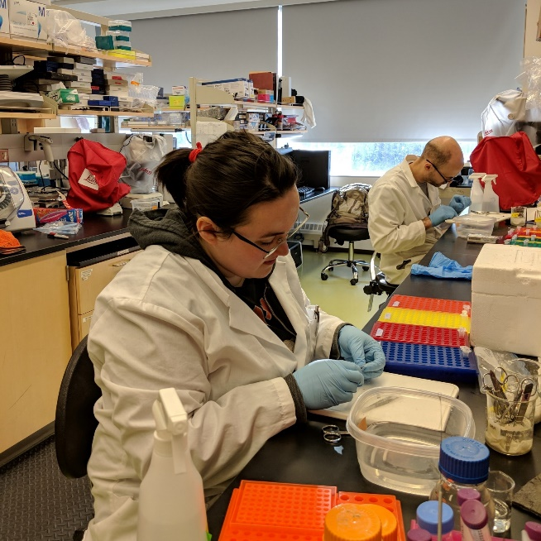
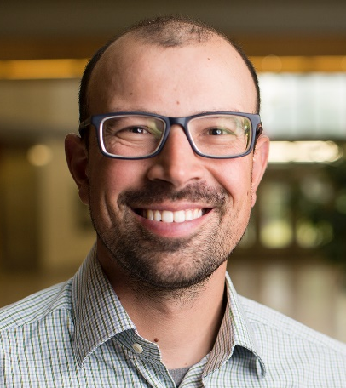
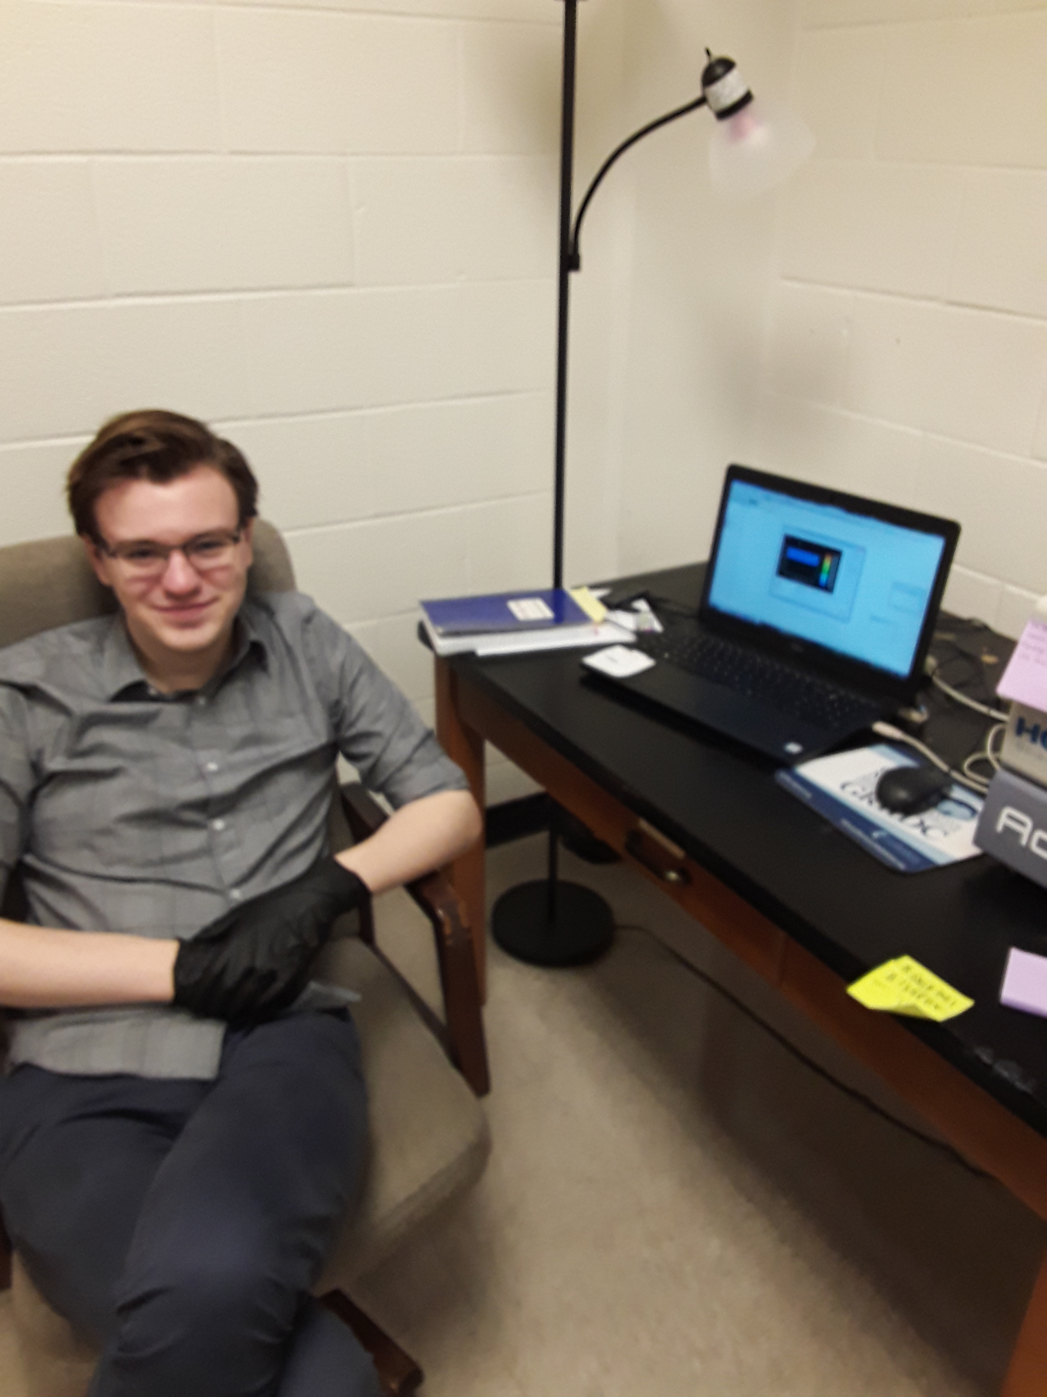
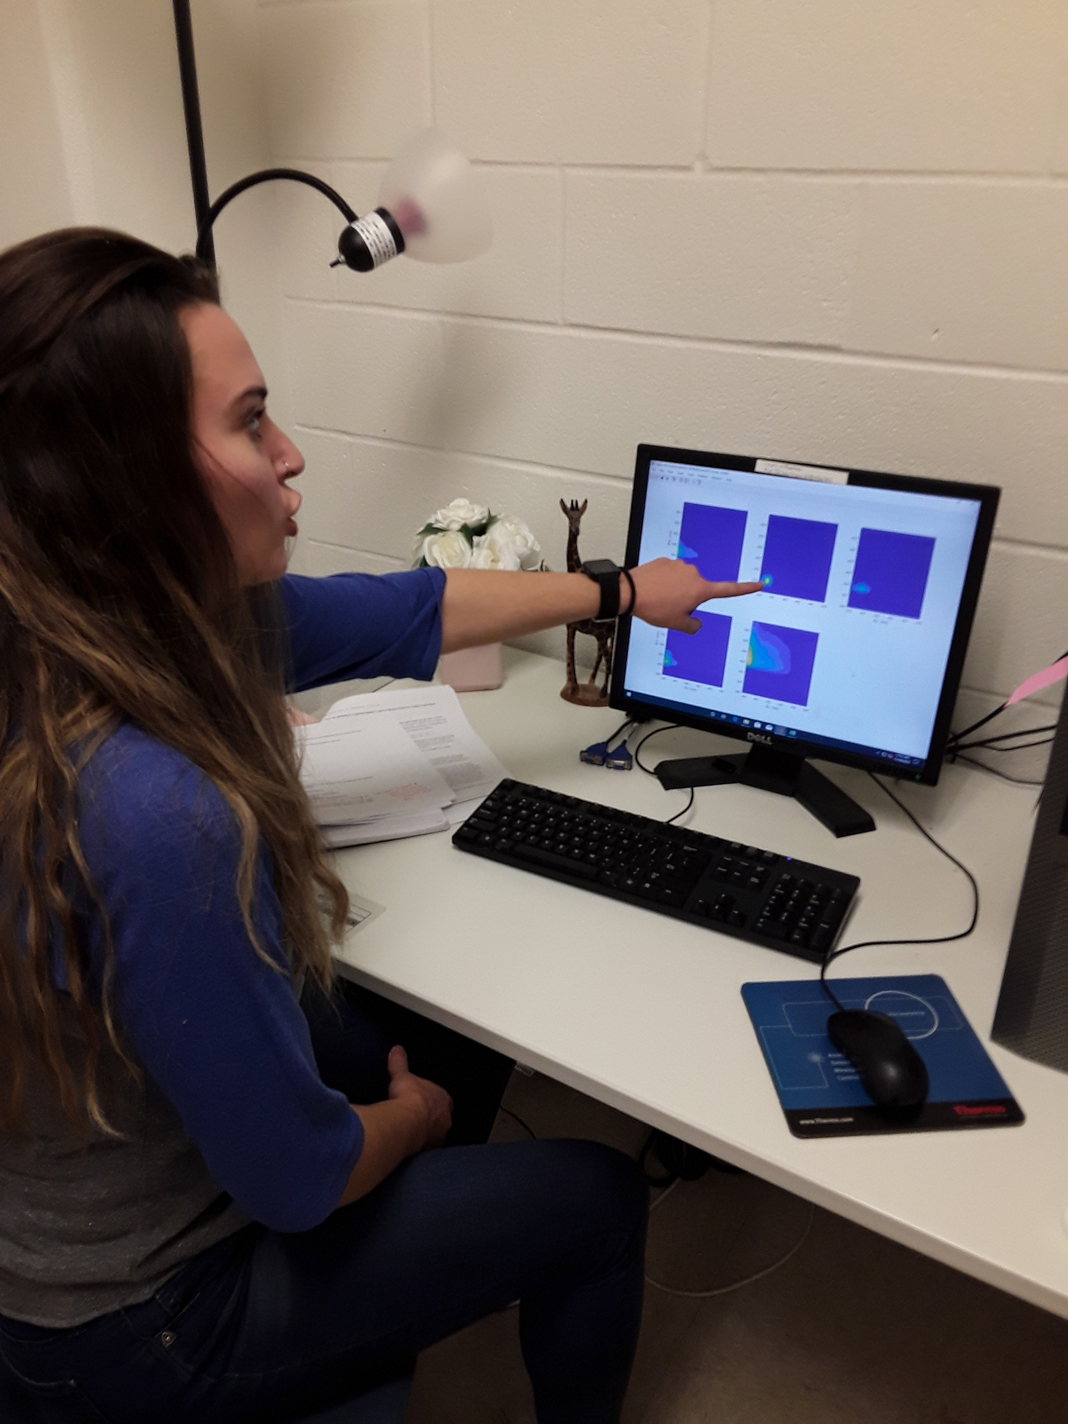
Ready for questions
ADAC Program Year 6 Annual Meeting 14 May 2020
Feedback…
What are we missing?
What can we improve?
Who should we connect with to improve odds of research success?
Notes:
Thank you for the gift of your time and attention.

